Slide 1
Unit 3 Direct Evidences of Evolution

Slide 2
Palaeontological Evidence
How Fossils are formed ?
Condition of Fossilization:
1) Possession of Hard parts.
2) Escape from immediate Destruction.
3) Immediate Burial in a Medium capable of
Retarding Decomposition.
4) Subsequent Changes.

Slide 3
Types of Fossils
Entire organism Preserved.
Original Hard part of Invertebrates Preserved.
Skeletons Preserved
Altered Hard part of Organism Preserved.
Traces of Organism Preserved.

Slide 4
Significance of Fossils
The Geological time table

Slide 5
Conclusions Drawn From Fossils Record
Palaeozoic
Mesozoic
Cenozoic
Dating of Fossils:
1) Absolute Dating
2) Relative Dating

Slide 6
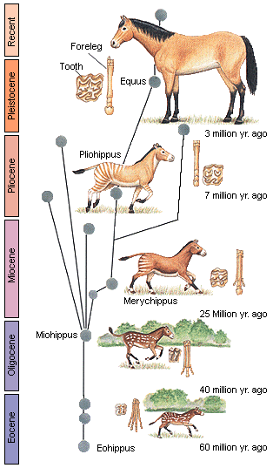
Phylogeny of Horse
Hyracotherium.
Mesohippus.
Merychippus.
Pliohippus.
Equus.

Slide 7
Imperfection of Fossils Record
Problems in Excavation of Fossils.
Problems of Fossilization.
Natural Destruction of Fossils.

Slide 8
Thank You..!

