Slide 1
402-EVOLUTIONARY BIOLOGY
"Nothing in biology makes sense except in the light of evolution"

Slide 2
UNIT:1 HISTORY OF LIFE
e- from; volvere- to roll means act of unrolling or unfolding.
Major events : Historical and Theories
1) Special Creation Theory:
a) Objection to special creation theory.
2) Hindu Concept Of Origin Of Life:

Slide 3
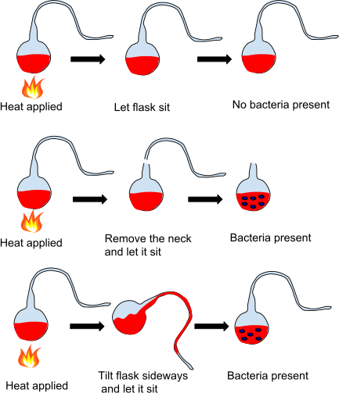
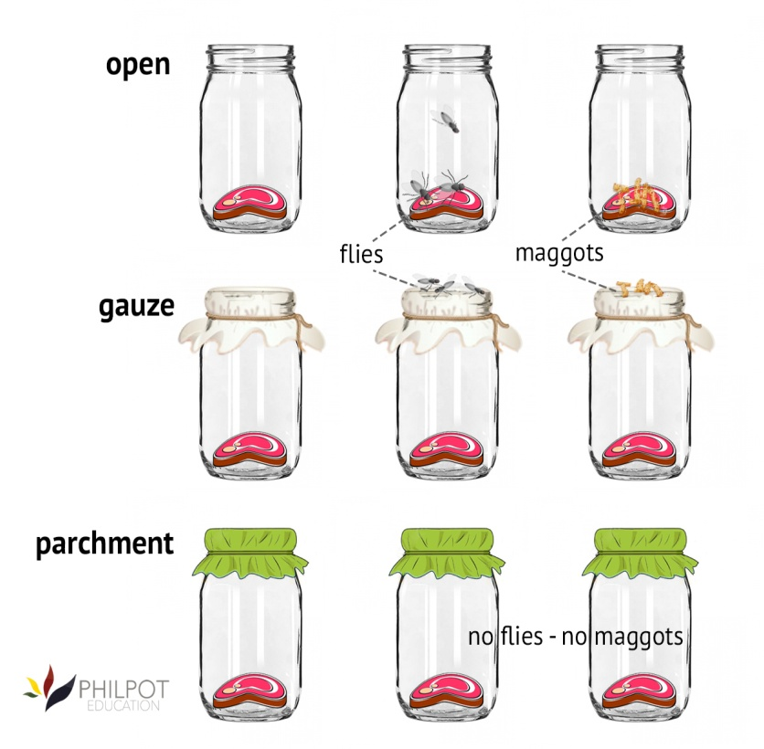
3) Theories Of Spontaneous Generation or Abiogenesis:
Disproof of Spontaneous Generation Theory:
Redi's experiment.
Pasteur's experiment.

Slide 4
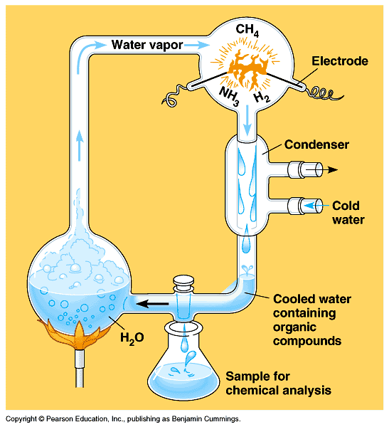
4) Hypothesis of Panspermia:
5) Theory Of Chemical Evolution and Spontaneous Origin Of Life At Molecular Level:
Millar's Experiment:

Slide 5
Process of Origin of Life
Structure of Cosmos:
Primitive Earth:
Prebiotic synthesis:
Evolution of Progenote:

Slide 6
Evolutions of Eukaryotes
Molecular Evolution.

Slide 7
THANK YOU…

