Slide 1
Unit- 5 Species Concepts

Slide 2
Biological Species Concepts
Advantages
Limitation

Slide 3
Mode of Speciation
Allopatric
Sympatric

Slide 4
Thank You…!

Slide 5
Unit – 6 Macro Evolution

Slide 6
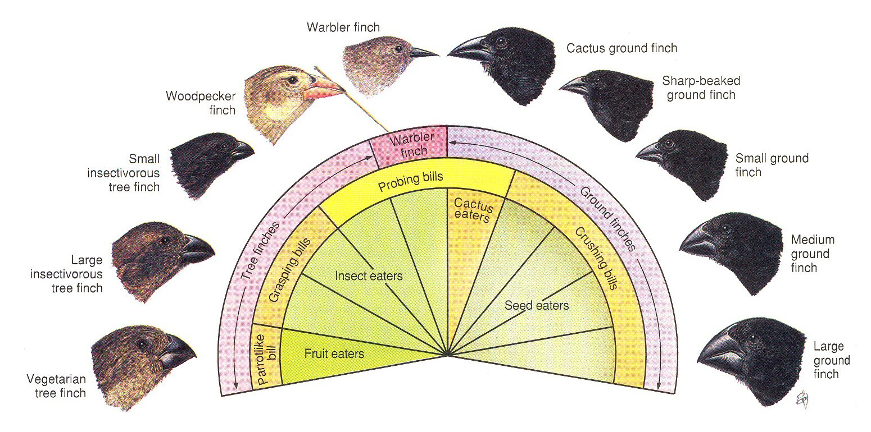
Macro Evolutionary Principles

Slide 7
Unit – 7 Extinction

Slide 8
Mass Extinction
A) Causes
B) Five Major Extinction :
Ordovician Mass Extinction
Devonian Mass Extinction
Permian Mass Extinction
Triassic-jurassic Mass Extinction
Cretaceous – Tertiary Mass Extinction

Slide 9
Role of Extinction in Evolution

Slide 10
Thank You..!

