Slide 1
DNA Replication
Presented By –
Pradnya V.Dhivare
Dept.Of Biotechnology

Slide 2
DNA replication is the process by which a double-stranded DNA molecule is copied to produce two identical DNA molecules. Replication is an essential process because, whenever a cell divides, the two new daughter cells must contain the same genetic information, or DNA, as the parent cell.

Slide 3
Types of Replication
Watson and Crick figured that this model would result in two new double strands of DNA, each one with one strand of parent (or template) DNA and one strand of daughter (or newly-synthesized) DNA. They called this the semi-conservative model, because half of the parent DNA was conserved in each new DNA molecule.
Scientists looked at the double helix of DNA and wondered how in the world it could possibly open itself up without getting tangled or torn apart. So they thought up some other ideas about how DNA replication works. One hypothesis, called the dispersive model, suggested that DNA only copied itself for short chunks at a time, producing new strands that alternated parent and daughter DNA. Another idea, called the conservative model, argued that DNA didn't split open at all, but somehow kept the parent strands intact while creating an entirely new and separate copy.

Slide 4
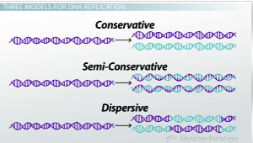

Slide 5
Meselson and Stahl Model
Meselson and Stahl decided the best way to tag the parent DNA would be to change one of the atoms in the parent DNA molecule. Remember that nitrogen is found in the nitrogenous bases of each nucleotide. So they decided to use an isotope of nitrogen to distinguish between parent and newly-copied DNA. The isotope of nitrogen had an extra neutron in the nucleus, which made it heavier.

Slide 6
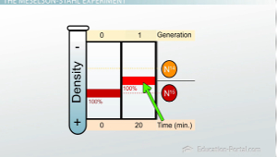
After one replication the DNA was converted to a hybrid of N15 and N16 DNA

Slide 7
Mechanism Of Replication
Key points:
DNA replication is semiconservative. Each strand in the double helix acts as a template for synthesis of a new, complementary strand.
New DNA is made by enzymes called DNA polymerases, which require a template and a primer (starter) and synthesize DNA in the 5' to 3' direction.
During DNA replication, one new strand (the leading strand) is made as a continuous piece. The other (the lagging strand) is made in small pieces.
DNA replication requires other enzymes in addition to DNA polymerase, including DNA primase, DNA helicase, DNA ligase, and topoisomerase.

Slide 8
