Slide 1
S.T.E.S. & Co-Op E.S. Ltd Science Senior College Shahada
ELE-302: Microprocessors and Applications
Unit 2: Architecture of 8085 Microprocessor.
Prepared By: Dr. Ulhas S. Sonawane
Asst. Professor,
Electronics Department,
S.T.E.S. & Co-Op E.S. Ltd
Science Senior College Shahada

Slide 2
Building Blocks of Processor Systems
CPU

Slide 3
Processor System Architecture
The typical processor system consists of:
  CPU (central processing unit)
    ALU (arithmetic-logic unit)
    Control Logic
    Registers, etc…
  Memory
  Input / Output interfaces
Interconnections between these units:
  Address Bus
  Data Bus
  Control Bus

Slide 4
Bus and CPU
Bus: A shared group of wires used for communicating signals among devices
  address bus: the device and the location within the device that is being accessed
  data bus: the data value being communicated
  control bus: describes the action on the address and data buses
CPU: Core of the processor, where instructions are executed
  High-level language: a = b + c
  Assembly language: add r1 r2 r3
  Machine language: 0001001010111010101

Slide 5
Memory and I/O
Memory: Where instructions (programs) and data are stored
  Organized in arrays of locations (addresses), each storing one byte (8 bits) in general
  A read operation to a particular location always returns the last value stored in that location
I/O devices: Enable system to interact with the world
  Device interface (a.k.a. controller or adapter) hardware connects actual device to bus
  The CPU views the I/O device registers just like memory that can be accessed over the bus. However, I/O registers are connected to external wires, device control logic, etc.
  Reads may not return last value written
  Writes may have side effects

Slide 6
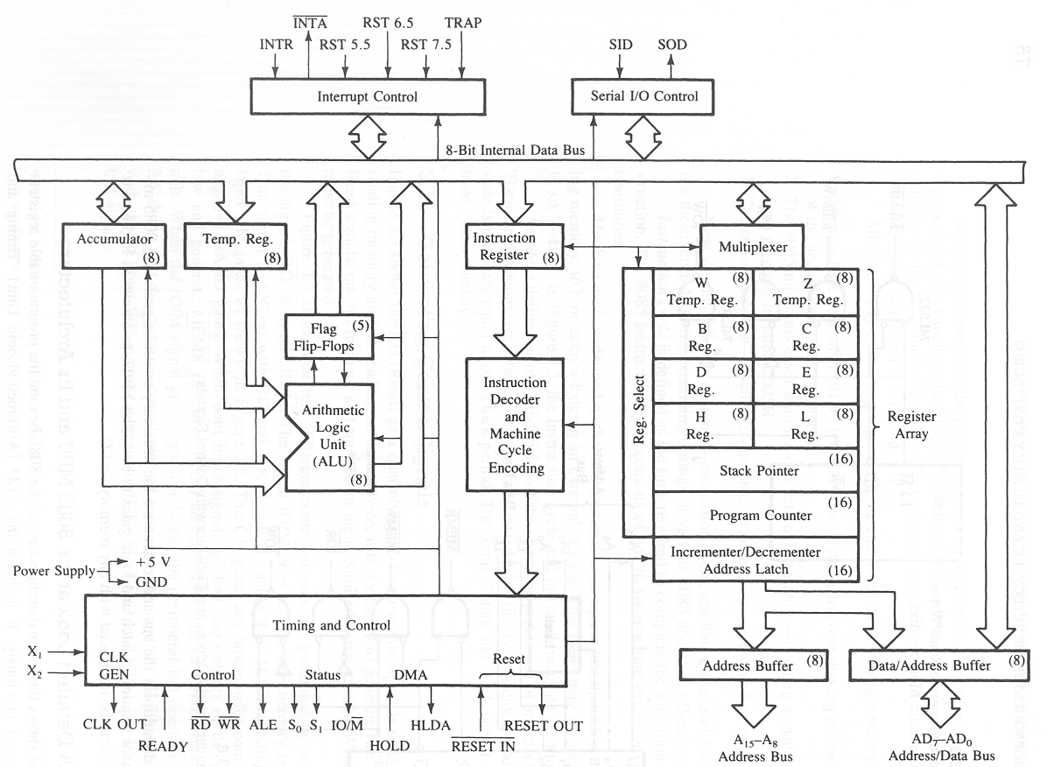
8085 Microprocessor Architecture

Slide 7
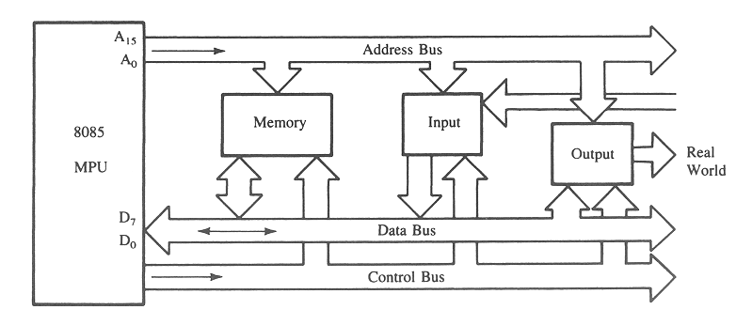
The 8085 Bus Structure
The 8-bit 8085 CPU (or MPU – Micro Processing Unit) communicates with the other units using a 16-bit address bus, an 8-bit data bus and a control bus.

Slide 8
The 8085 Bus Structure
Address Bus
  Consists of 16 address lines: A₀ – A₁₅
  Operates in unidirectional mode: The address bits are always sent from the MPU to peripheral devices, not reverse.
  16 address lines are capable of addressing a
  total of 2¹⁶ = 65,536 (64k) memory locations.
  Address locations: 0000 (hex) – FFFF (hex)

Slide 9
The 8085 Bus Structure
Data Bus
  Consists of 8 data lines: D₀ – D₇
  Operates in bidirectional mode: The data bits are sent from the MPU to peripheral devices, as well as from the peripheral devices to the MPU.
  Data range: 00 (hex) – FF (hex)
Control Bus
  Consists of various lines carrying the control signals such as read / write enable, flag bits.

Slide 10
The 8085: CPU Internal Structure
The internal architecture of the 8085 CPU is
capable of performing the following operations:
  Store 8-bit data (Registers, Accumulator)
  Perform arithmetic and logic operations (ALU)
  Test for conditions (IF / THEN)
  Sequence the execution of instructions
  Store temporary data in RAM during execution

Slide 11
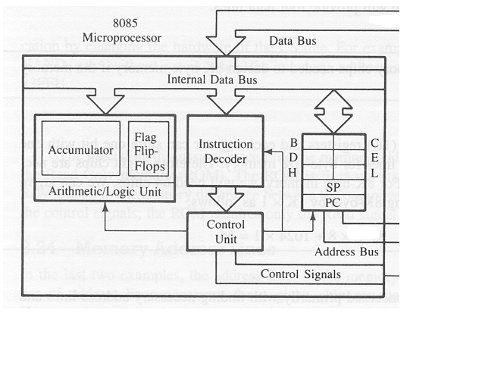
The 8085: CPU Internal Structure
Simplified block diagram

Slide 12
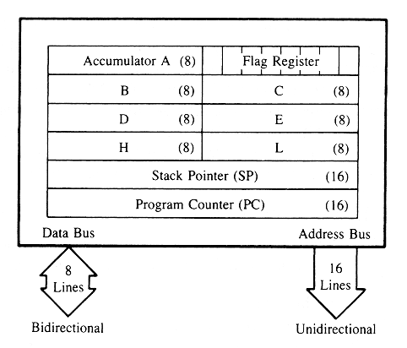
The 8085: Registers

Slide 13
The 8085: CPU Internal Structure
Registers
  Six general purpose 8-bit registers: B, C, D, E, H, L
  They can also be combined as register pairs to
  perform 16-bit operations: BC, DE, HL
  Registers are programmable (data load, move, etc.)
Accumulator
  Single 8-bit register that is part of the ALU !
  Used for arithmetic / logic operations – the result is always stored in the accumulator.

Slide 14
The 8085: CPU Internal Structure
Flag Bits
  Indicate the result of condition tests.
  Carry, Zero, Sign, Parity, etc.
  Conditional operations (IF / THEN) are executed based on the condition of these flag bits.
Program Counter (PC)
  Contains the memory address (16 bits) of the instruction that will be executed in the next step.
Stack Pointer (SP)

Slide 15
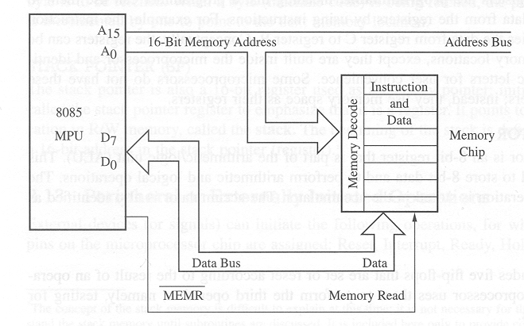
Example: Memory Read Operation

Slide 16
Example: Instruction Fetch Operation
  All instructions (program steps) are stored in memory.
  To run a program, the individual instructions must be read from the memory in sequence, and executed.
    Program counter puts the 16-bit memory address of the
    instruction on the address bus
    Control unit sends the Memory Read Enable signal to
    access the memory
    The 8-bit instruction stored in memory is placed on the data
    bus and transferred to the instruction decoder
    Instruction is decoded and executed

Slide 17
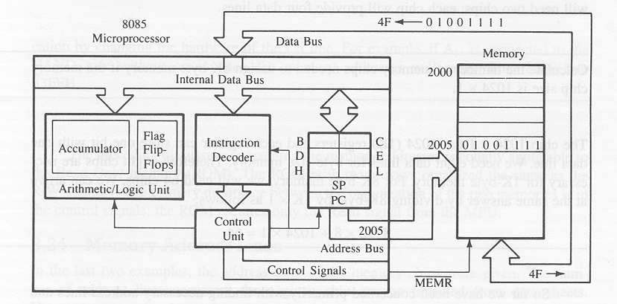
Example: Instruction Fetch Operation

Slide 18
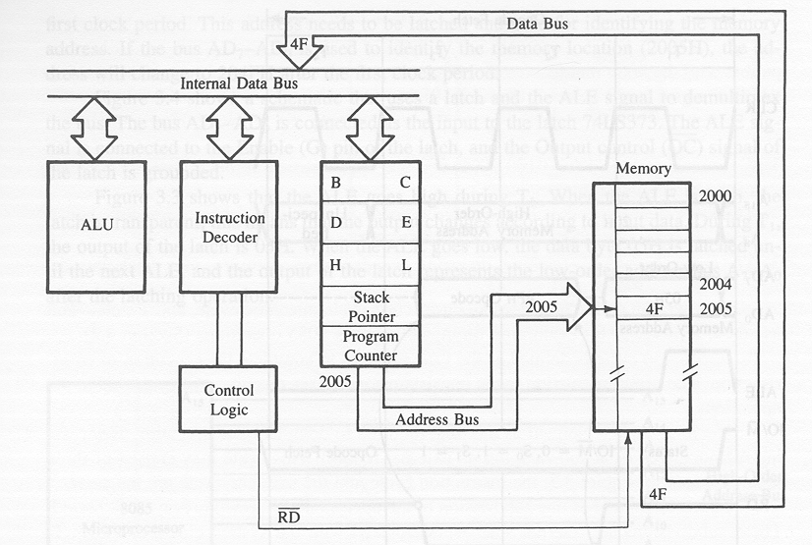
Example: Instruction Fetch Operation

Slide 19
8085 Functional Block Diagram

