Slide 1
COLLIGATIVE PROPERTIES
:- Asst. Prof. Sachin P Patil Chemistry Department S T Co-Op Education Society’s, Science Senior College, Shahada.

Slide 2
COLLIGATIVE PROPERTIES
Elevation of Boiling Point
Depression of Freezing Point
Lowering of Vapor Pressure
Osmotic Pressure

Slide 3
MOLE FRACTION & MOLALITY
MOLE FRACTION OF Component i
= X_{i} = n _{i} / n _{total}
(c.f Gases; Chapter 5, p.217)
MOLALITY = Moles of Solute / kg Solvent

Slide 4
MOLALITY
Useful when Temperature Changes are considered, as Volumes of solutions change with changing temperature, whereas Masses of Solvents do not!
Note: In dilute solutions, Molarity & Molarity have nearly the same values!

Slide 5
DILUTE AQUEOUS SOLUTIONS
e.g. 1 M NaCl = 1 Mol NaCl/L
= 31.449 g NaCl / 1 L solution
But: 1 L water weighs 1.00 kg at 20 ⁰C
∴ In dilute solution,
Molality ≈ Molarity

Slide 6
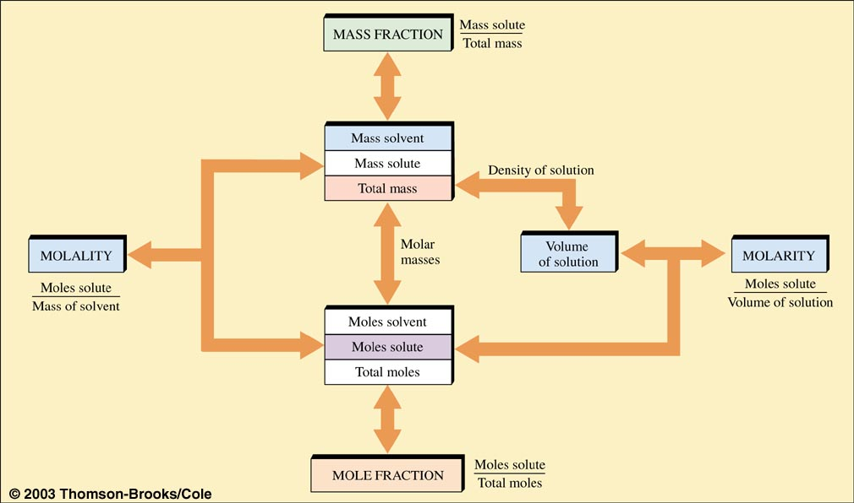
CONVERSIONS BETWEEN SOLUTION PROPERTIES

Slide 7
RAOULT’S LAW
In Ideal Solutions:
P₁ = X₁ P₁⁰
Note: P₁⁰ = Vapor Pressure of Pure Solvent

Slide 8
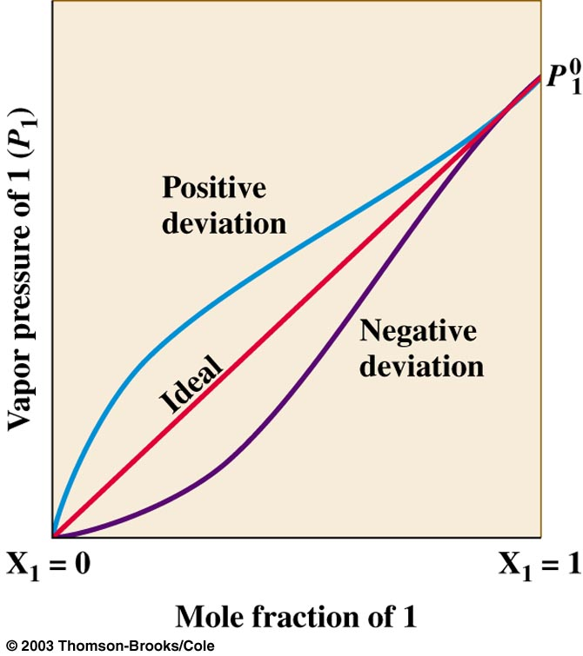
VAPOR PRESSURE OF SOLVENT (P₁) vs. MOLE FRACTION OF SOLVENT (X₁)

Slide 9
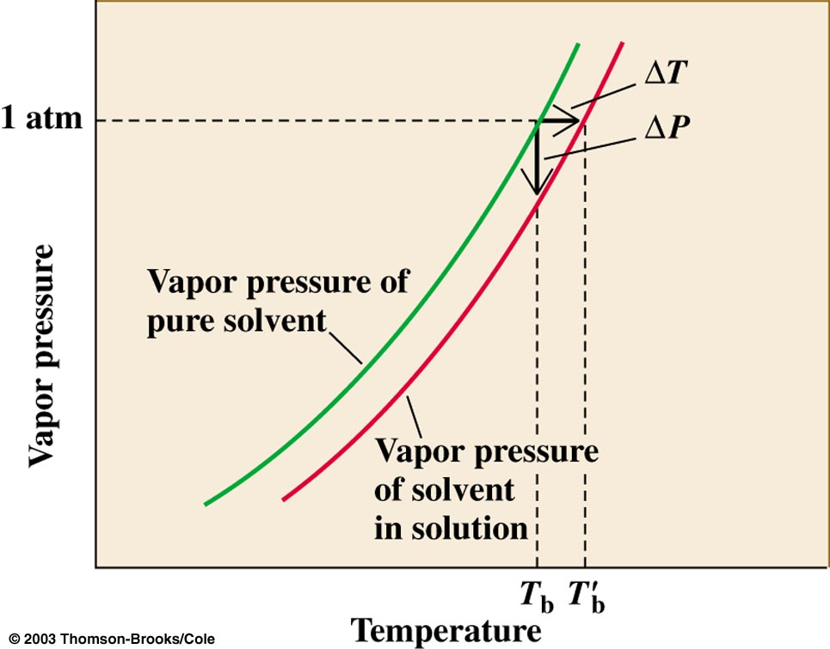
ELEVATION OF BOILING POINT

Slide 10
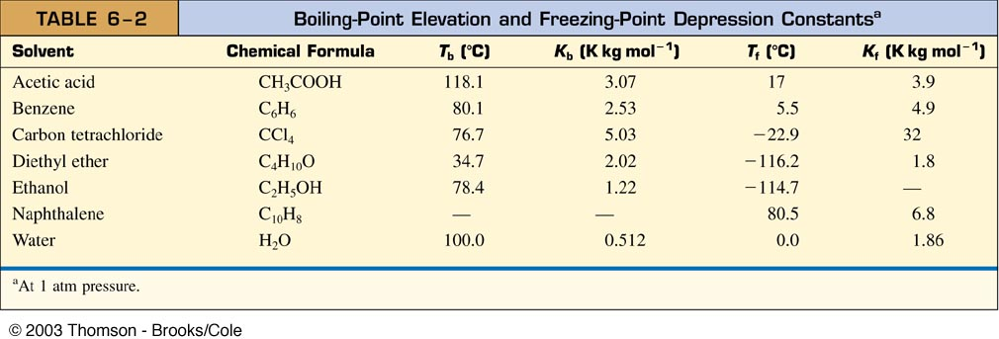
BPt. & F. Pt.

Slide 11
Van’t HOFF FACTOR
Dissociation of Solute to more particles
i.e. Freezing Pt. Depression:
Δ T_{f} = imK _{f} or
Boiling Point Elevation:
Δ T_{b} = imK _{b}
where Δ T_{b} = Boiling pt. Elevation,
Δ T_{f} = Freezing pt. depression K _{f} = F. Pt depression const.
K _{b} = B.Pt elevation const.

Slide 12
Van’t HOFF FACTOR
Δ T_{f} = imK _{f}
i = No. of particles in solution per formula unit (range 1 – n)
i.e. for sucrose i = 1 [no dissociation]
for NaCl i = 2 [NaCl → Na⁺+Cl⁻]
for K₂SO₄ i = 3 [K₂SO₄ → 2K⁺ + SO₄²⁻ ]

Slide 13
Van’t HOFF FACTOR
i has maximum value of υ (Gk nu), when dissociation is complete, but association through ion-pairs often occurs, which makes i < υ.

Slide 14
FRREZING POINT DEPRESSION EXAMPLE
Home work Problem Chapter 6 No.44
44. If NaCl, CaCl₂ and Urea used to melt street ice. Which is best?

Slide 15
Thank you

